Slide 1
Springboard Data Science Intensive
Arun S Bharadwaj
Thanks to my mentor Alex Chao and student advisor Chris Giuffre
December 2017

Slide 2
Portfolio theory using data science and machine learning
Introduction
Goal is to understand portfolio theory (equity investing) using data science and machine learning
Intended audience for the project are hedge fund managers, academics and students of portfolio theory
Financial markets produce large datasets of different types: technical, fundamental and macroeconomic. This project uses a fundamental dataset for modelling market capitalization and stock price returns

Slide 3
Portfolio theory using data science and machine learning
StockPup Dataset
Dataset downloaded from StockPup.com, consisting of 739 csv files
Each file has information about a company`s profit and loss, balance sheet, cash flow and stock price data from 1993 to 2017, for quarterly periods
In addition to this, GDP, Inflation and S&P500 returns data are used. While GDP and Inflation are important predictors of stock prices, the S&P500 is the benchmark used to compare the performance of money managers
Numerical, time-series data with detailed information about a company`s financial structure for a period of 24 years

Slide 4
Portfolio theory using data science and machine learning
Approach to problem solving
Identify problem statement
What questions should be answered using the dataset to solve this problem
Data Wrangling
Exploratory data analysis
Statistical Inference
Conclusions
Recommendations
Machine Learning

Slide 5
Portfolio theory using data science and machine learning
Problem Statement
Project aims to understand the factors driving stock price returns
To do this, we first try to find a relationship between fundamental data and market capitalization
Next, we find the probability of a stock`s annual rate of return exceeding the S&P500`s rate of return and understand the reasons why this happens
The ability of money managers to outperform the stock market benchmark is a controversial subject. While some academics believe that stock prices can be predicted using technical, fundamental and macroeconomic factors, others believe that stock prices are a random function and cannot be predicted

Slide 6
Steps in Data Wrangling
Extract all 739 csv files
Since the name of company is only seen in the csv filename, wrangling ensures that company name appears in each row of the csv file
Kalman filtering was done to replace missing values

Slide 7
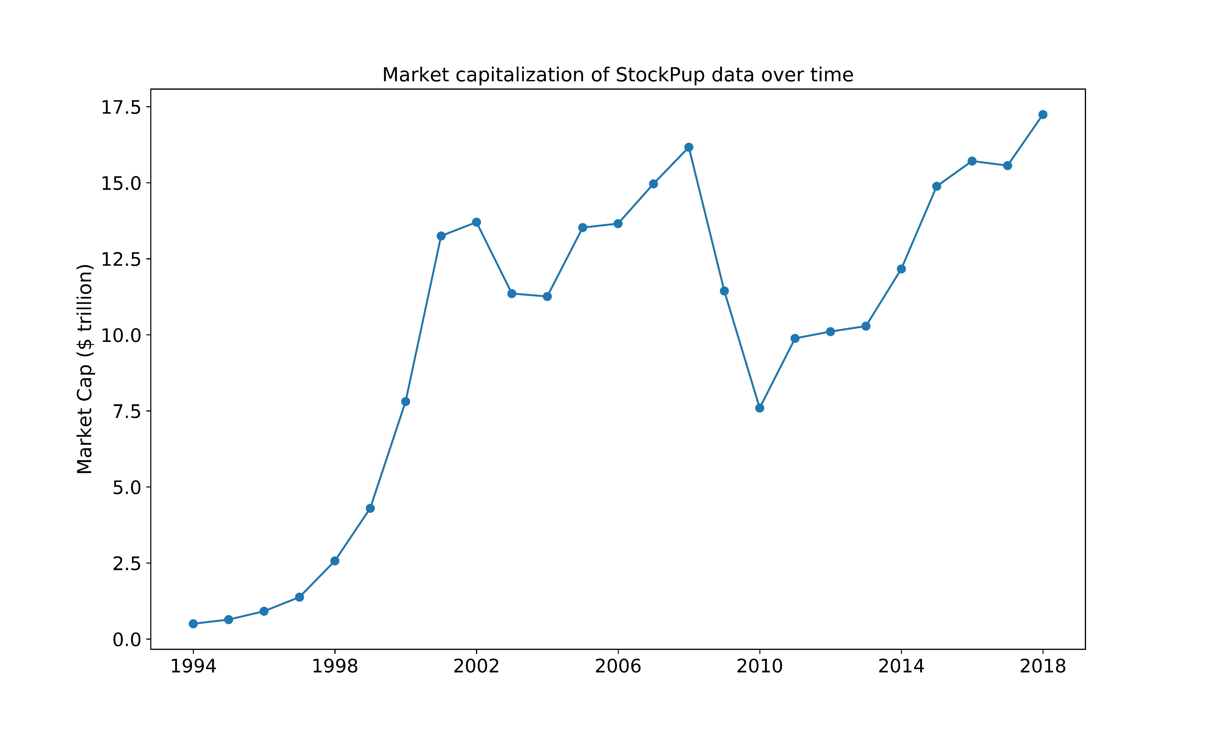
Exploratory Data Analysis (Market Cap)
Market capitalization of StockPup data showing steady increases, with large drops during years of financial crises

Slide 8
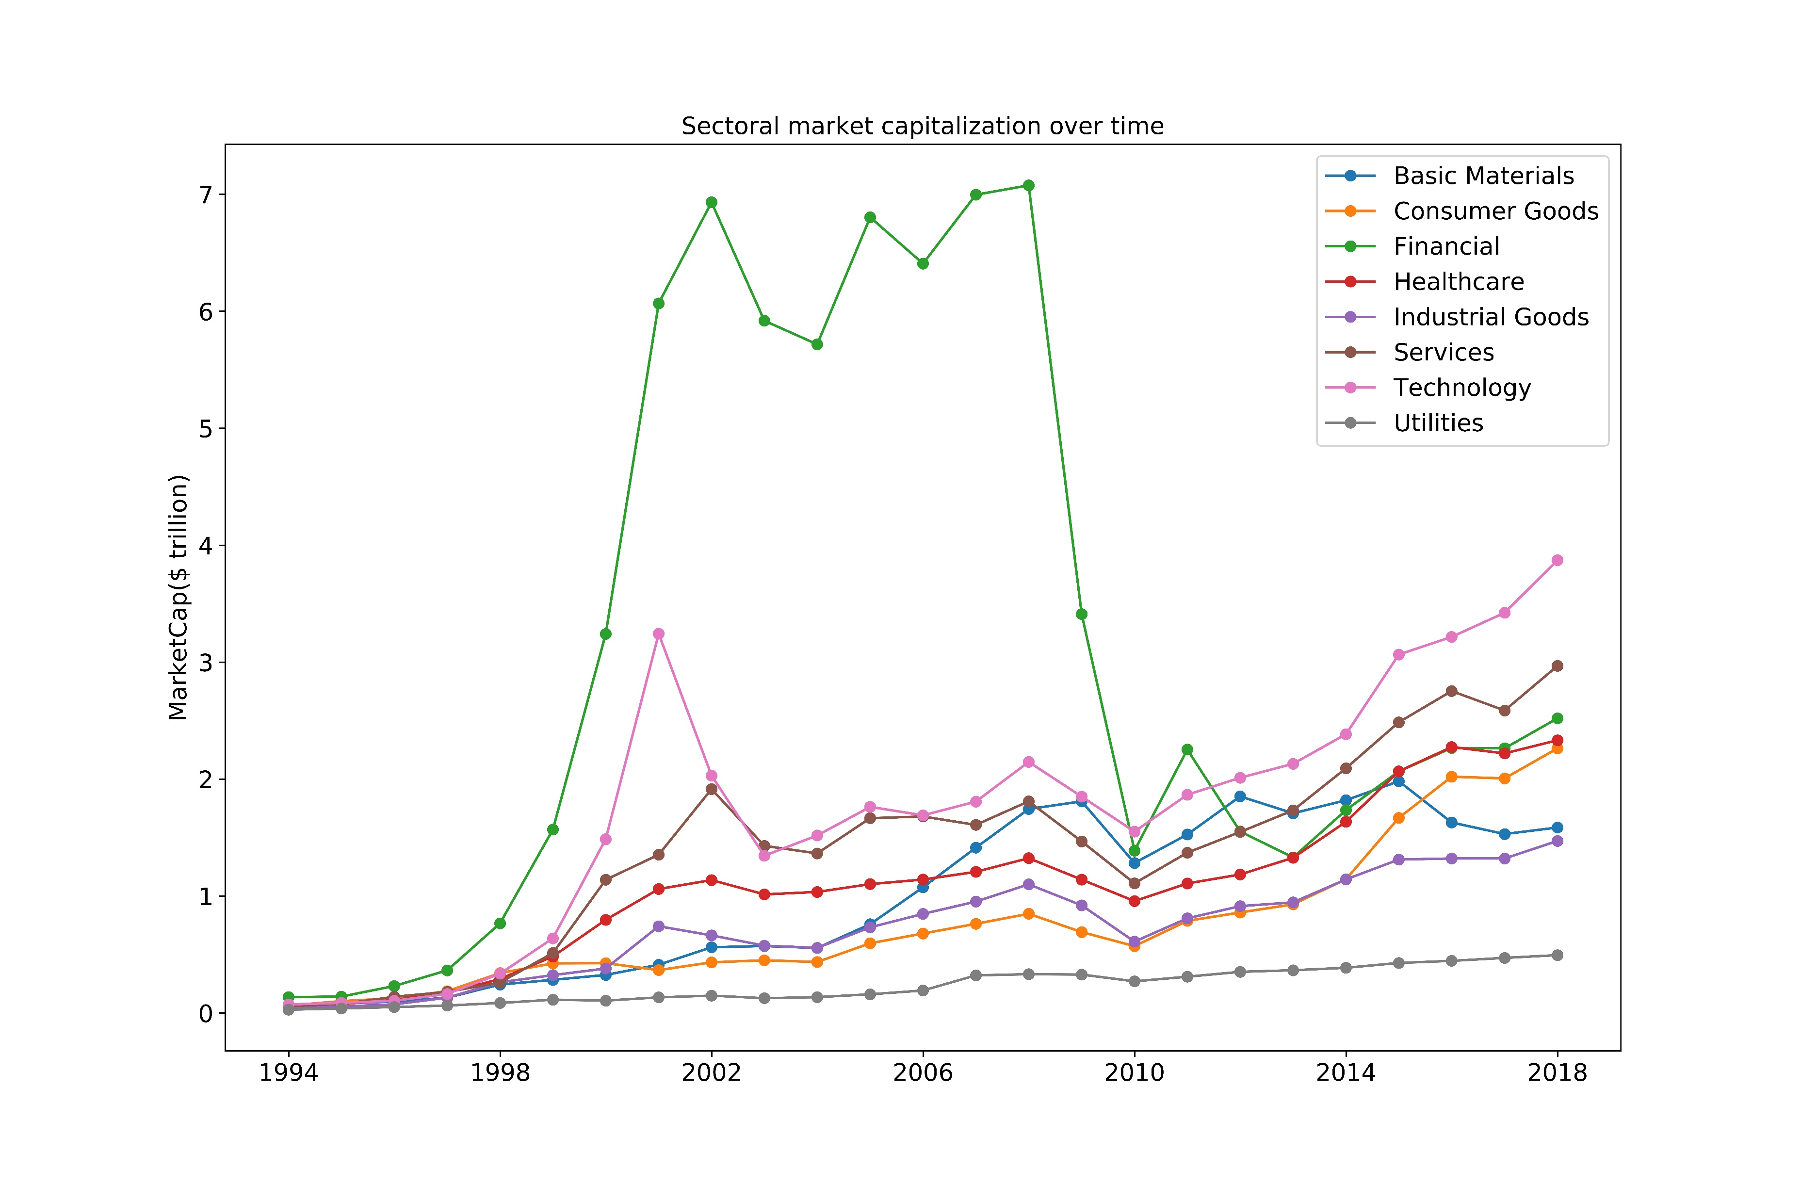
Exploratory Data Analysis (Sectoral market cap)
Financial sector had highest market capitalization until 2010-11, after which it was overtaken by the technology sector

Slide 9
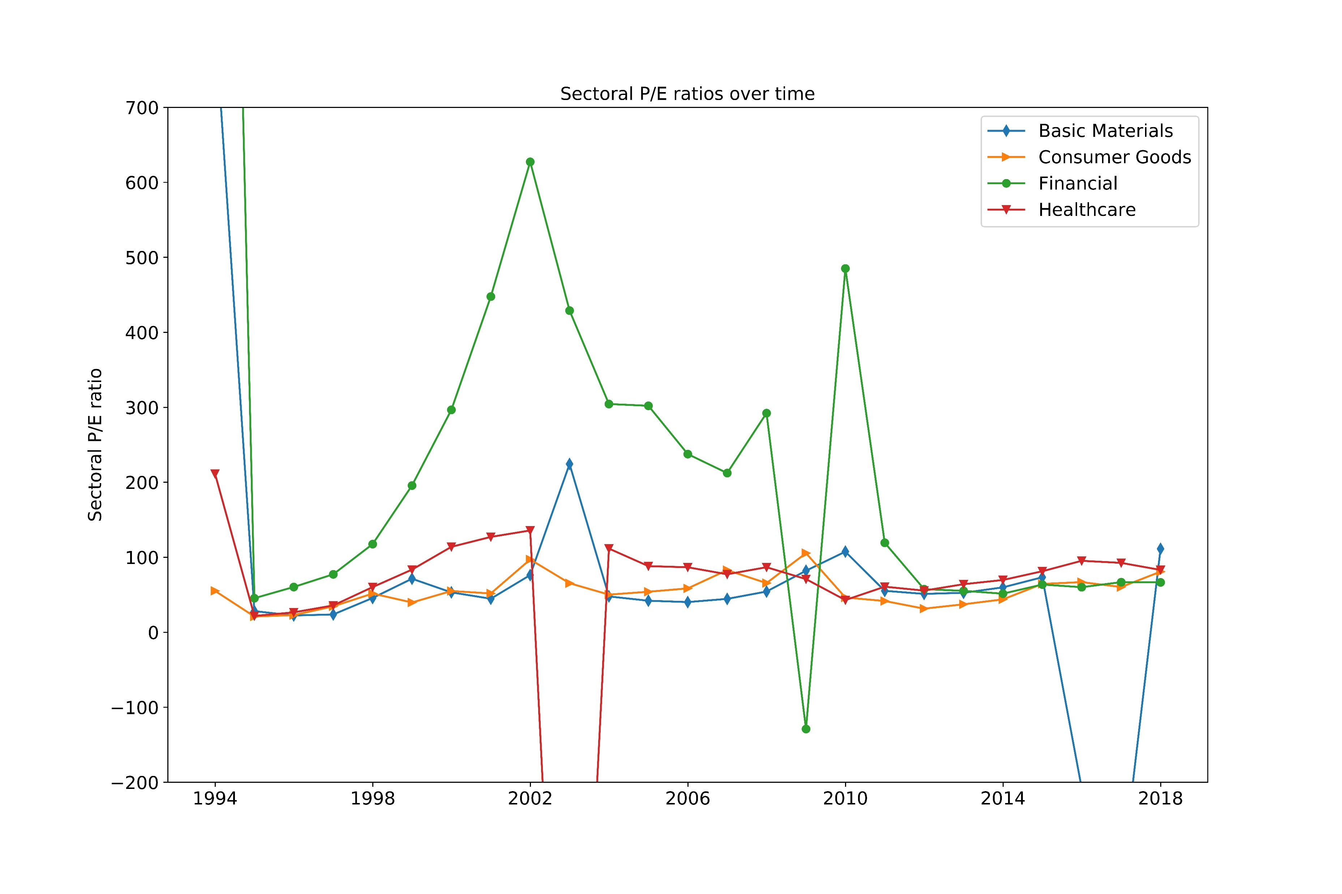
Exploratory Data Analysis (Sectoral P/E ratio)
The plot shows large peaks for 2002 and 2010, the years that succeeded financial crises. These peaks were likely caused by large drop in earnings due to the crises, which was not matched by a proportional drop in market capitalization

Slide 10
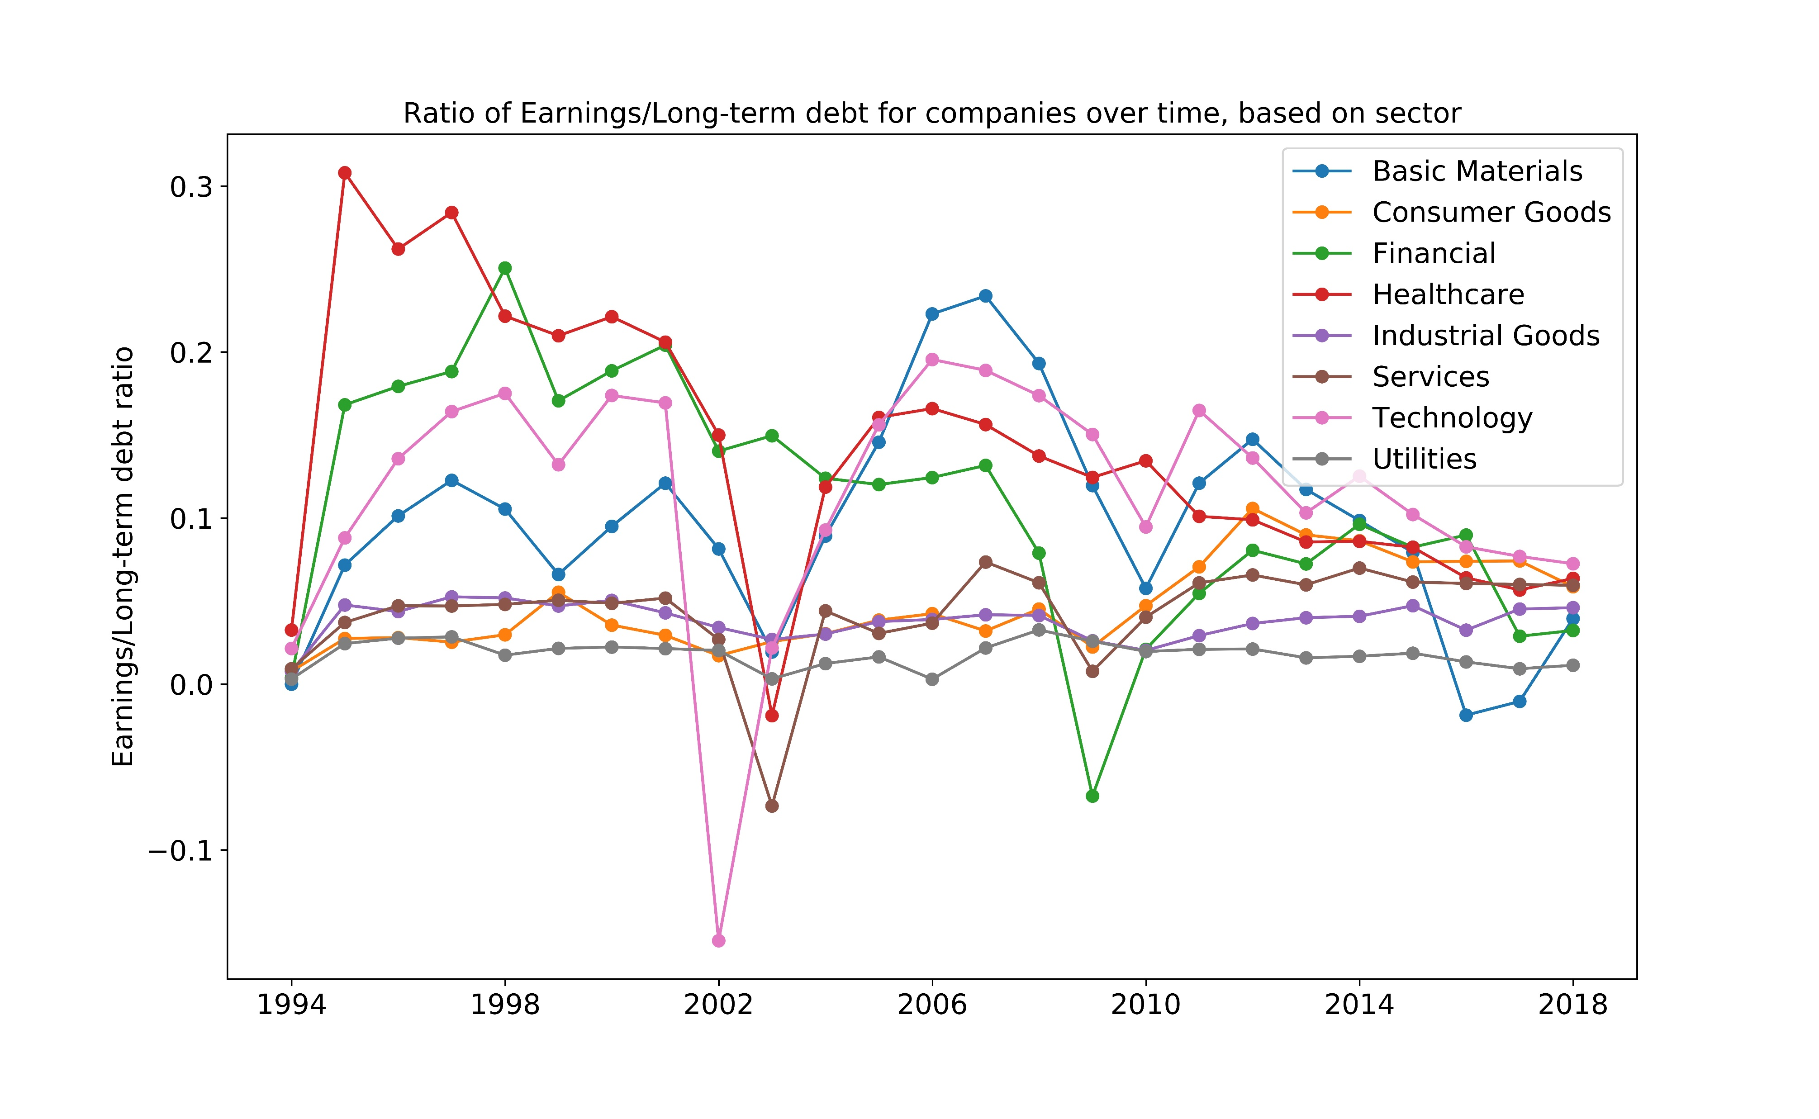
Exploratory Data Analysis (Sectoral earnings to long term debt)
Plot shows high volatility. Ratio dips in 2002 for technology sector and in 2009 for financials, crises years

Slide 11
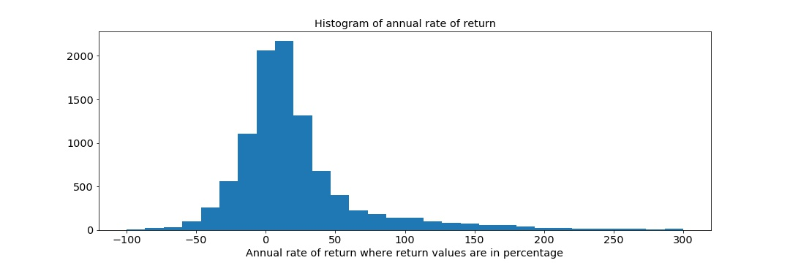
Exploratory Data Analysis (Stock price annual rate of returns)
For the complete dataset, we observe mean annual rate of returns of 29%, standard deviation of 106% and median annual rate of return of 11%. In reality, an average investor will only be able to generate the 11% annual rate of return.

Slide 12
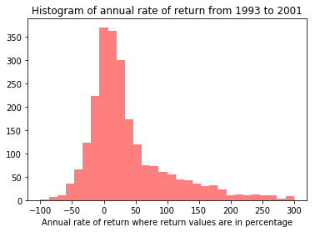
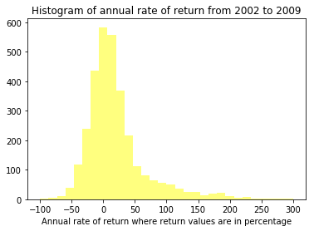
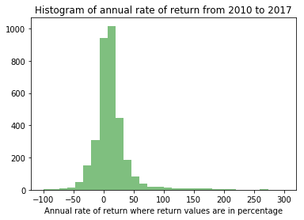
Exploratory Data Analysis (Stock price annual rate of returns split based on time periods)
 | 1993 - 2001 | 2002 - 2009 | 2010 – 2017
Mean | 60 % | 22 % | 15 %
Standard deviation | 184 % | 78 % | 38 %
Median | 20 % | 8 % | 10 %
Mean and standard deviation of annual rate of returns are falling consistently over time. With time, the histogram bars are less scattered and have higher peaks

Slide 13
Exploratory Data Analysis (Stock price annual rate of returns split based on company size)
 | < $ 1 billion | $ 1 – 10 billion | $ 10 – 30 billion | > $ 30 billion
Mean | 43 % | 19 % | 9 % | 12 %
Standard deviation | 109 % | 45 % | 23 % | 44 %
Median | 18 % | 11 % | 7 % | 6 %
Median annual rate of return decreases with increasing company size

Slide 14
Exploratory Data Analysis (Stock price annual rate of returns split based on sector)
 | Basic materials | Consumer goods | Financials | Healthcare | Industrial goods | Services | Technology | Utilities
Mean | 24 % | 26 % | 22 % | 35 % | 23 % | 28 % | 47 % | 18 %
Standard deviation | 59 % | 68 % | 51 % | 100 % | 46 % | 103 % | 194 % | 86 %
Median | 11 % | 11 % | 13 % | 14 % | 14 % | 11 % | 12 % | 10 %
On a risk adjusted basis, by using median rate of returns and standard deviation, Industrial goods perform the best

Slide 15
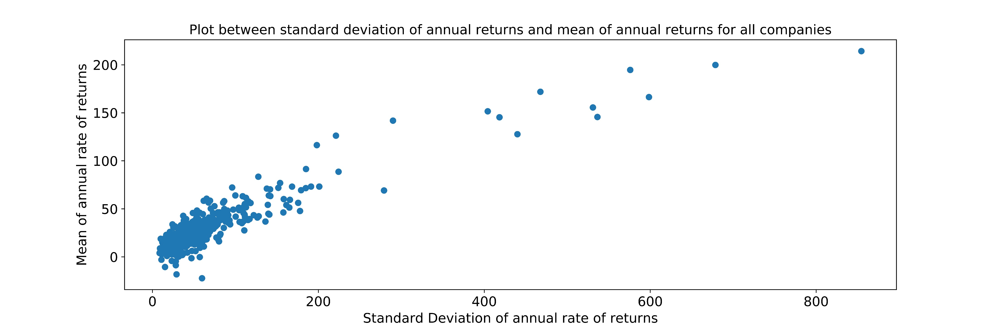
Exploratory Data Analysis (Stock price annual rate of returns versus standard deviation of returns)
Shape of plot shows that as mean of annual rate of return increases, the risk or standard deviation of the stock also increases. The plot is very similar to the Markowitz frontier, a right facing parabola drawn between the above two variables. This plot misses the lower half of the parabola since our dataset seems to have survivorship bias.

Slide 16
Statistical Inference
NULL HYPOTHESES
Difference between sectoral P/E ratios of different sectors is not significant
Difference between sectoral earnings to long term debt ratio of different sectors is not significant
Difference between mean of annual rate of return divided based on different time periods is not significant
Difference between mean of annual rate of return divided based on company size is not significant
Difference between mean of annual rate of return divided based on sector is not significant
Bootstrap resampling with replacement was done on raw data and hypothesis testing was performed using the tukey hsd multiple comparison of means approach. The difference in sample means of sectoral P/E ratios between 7 pairs of sectors, returns of all time periods, returns of 5 pairs of company sizes and the returns divided based on sectors were found to be statistically significant.

Slide 17
Machine Learning
ALGORITHM | DEPENDENT VARIABLE | INDEPENDENT VARIABLE
OLS LINEAR REGRESSION | Market Capitalization | Earnings Free Cash Flow
LOGISTIC REGRESSION | AlphaReturn | GDP Inflation Price to Book ratio
RANDOM FOREST | AlphaReturn | All features
SUPPORT VECTOR MACHINE | AlphaReturn | All features
AlphaReturn is calculated by subtracting S&P500 return from annual stock return. While linear regression tries to predict numerical values of market capitalization, the other algorithms predict the probability of a stock outperforming the S&P500

Slide 18
Machine Learning
ALGORITHM | MODEL PARAMETERS | MODEL PERFORMANCE AND VALIDATION
OLS LINEAR REGRESSION | R-squared = 0.382 | Plot between actual and predicted values of market capitalization show poor correlation Residuals versus fitted plot has unnatural shape Residuals are not normally distributed
 | Earnings [Co-Efficient, p-value] = [27,0]
 | Free Cash Flow [Co-Efficient, p-value] = [24,0]
LOGISTIC REGRESSION | Model Accuracy = 0.538 | K-fold cross validation and grid search cross validation have model accuracies of 0.53 and 0.57 respectively Positive value of price to book ratio co-efficient is intuitive since an increase in price to book ratio is likely due to an increase in price.
 | GDP [Co-Efficient, p-value] = [32,0]
 | Inflation [Co-Efficient, p-value] = [7.5,0.047]
 | Price to Book ratio [Co-Efficient, p-value] = [0.017,0.49]
RANDOM FOREST | Model Accuracy = 0.6 | Useful for identifying features with highest importance. These features in-turn can be used in logistic regression.
 | Feature Importance (top 3) = [(GDP, 0.075), (Inflation, 0.064), (Price to book ratio, 0.06)]
SUPPORT VECTOR MACHINE | Model Accuracy = 0.53 | Model accuracy not better than logistic regression
Random forest has the best model accuracy for this dataset

Slide 19
Machine Learning Implications
LINEAR REGRESSION | Model with earnings and free cash flow can explain 38% of deviation of actual values of market capitalization from fitted values Positive values of co-efficient`s of earnings and free cash flow is intuitive since an increase in these variables increases market capitalization Large value of condition number indicates multi-collinearity of earnings and free cash flow.
LOGISTIC REGRESSION | Positive value of co-efficient of price to book ratio is intuitive since an increase in price to book ratio is likely to occur due to an increase in price. This increases the chances of a stock outperforming the benchmark Model accuracy of 53 % shows that logistic regression is only partially better than a human guessing model for our dataset
RANDOM FOREST | Feature importance attribute of random forest algorithm is useful in explaining the features that are best at modelling AlphaReturn
SUPPOR VECTOR MACHINE | Generates hyperplane classifier that ensures maximum distance between the classes. Support vector machine is also only marginally better than a human guessing model for our dataset
Simple, high bias algorithms like linear regression perform poorly. Presence of correlated independent variables makes it unsuitable

Slide 20
Conclusions and Recommendations
CONCLUSION
Fundamental accounting data cannot model market capitalization
Fundamental accounting data suffers from multi-collinearity due to accounting equation
Random forest is best suited for modelling stock price returns
Future earnings and future free cash flow are better than current earnings and free cash flow at predicting market capitalization
Finding a way to incorporate unstructured and technical price movement data is important
OBSERVATIONS AND RECOMMENDATION
Fundamental data misses out on unstructured information like quality of management, future earnings, intangible value etc
Do not use algorithms like linear and logistic regressions to model market capitalization and stock returns
Simple, high bias algorithms like linear regression do not work well
Fundamental data does not include projected figures. Models that incorporate future information will perform better
Features related to unstructured data are complex and difficult to incorporate

